Slide 1
Introduction to the perceptron
Topics:
Linear discriminant classifier
Concept of biological and artificial neurons
Perceptrons and multilayer perceptrons
Activation functions
Training
Artificial neural networks (anns)
Deep learning and artificial neural network

Slide 2
Linear Discriminant Classifier

Slide 3
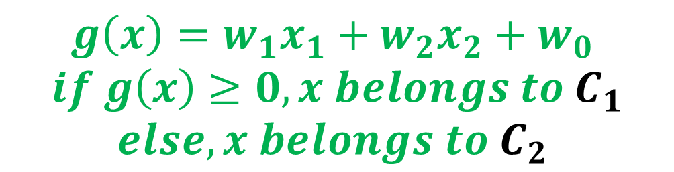
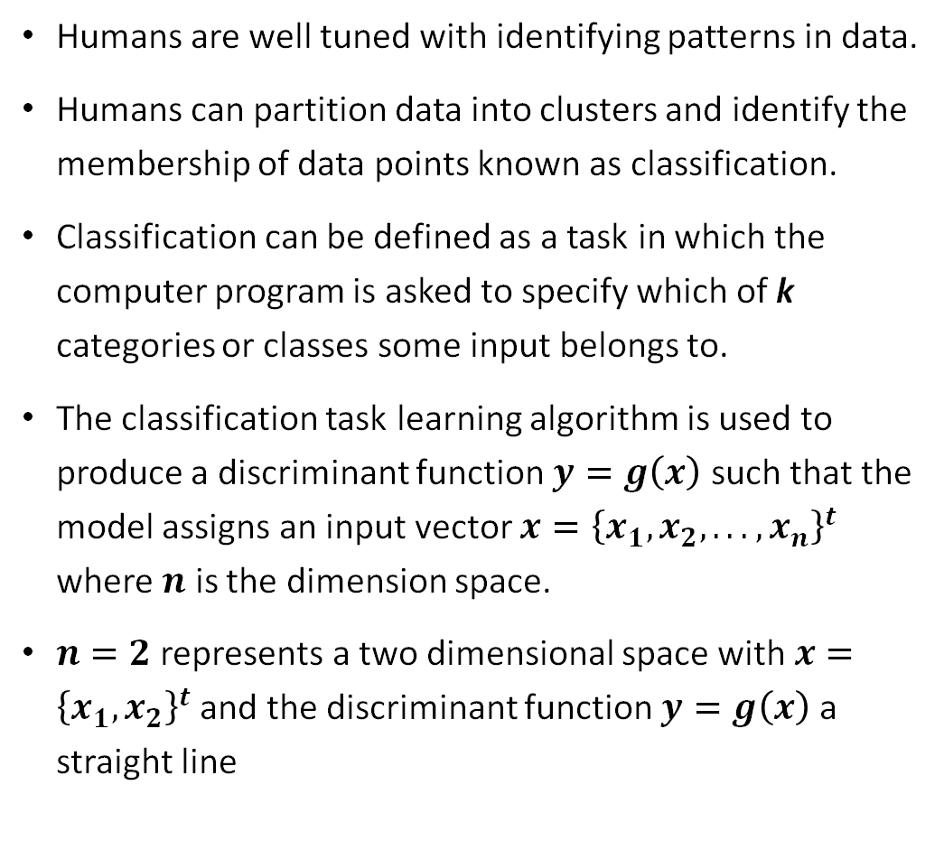



Linear discriminant classifier
Humans are well tuned with identifying patterns in data.
Humans can partition data into clusters and identify the membership of data points known as classification.
Classification can be defined as a task in which the computer program is asked to specify which of k categories or classes some input belongs to.
The classification task learning algorithm is used to produce a discriminant function $y=g\left(x\right)$ such that the model assigns an input vector $x={\left\{x_{1}, x_{2}, . . ., x_{n}\right\}}^{t}$ where $n$ is the dimension space.
$n=2$ represents a two dimensional space with $x={\left\{x_{1}, x_{2}\right\}}^{t}$ and the discriminant function $y=g\left(x\right)$ a straight line
$$g\left(x\right)>0$$
C₁
C₂
$$g\left(x\right)<0$$
+
$$g\left(x\right)$$
$$g\left(x\right)=w_{1}x_{1}+w_{2}x_{2}+w_{0}$$
$$if g\left(x\right)≥0, x belongs to C_{1}$$
$$else, x belongs to C_{2}$$

Slide 4
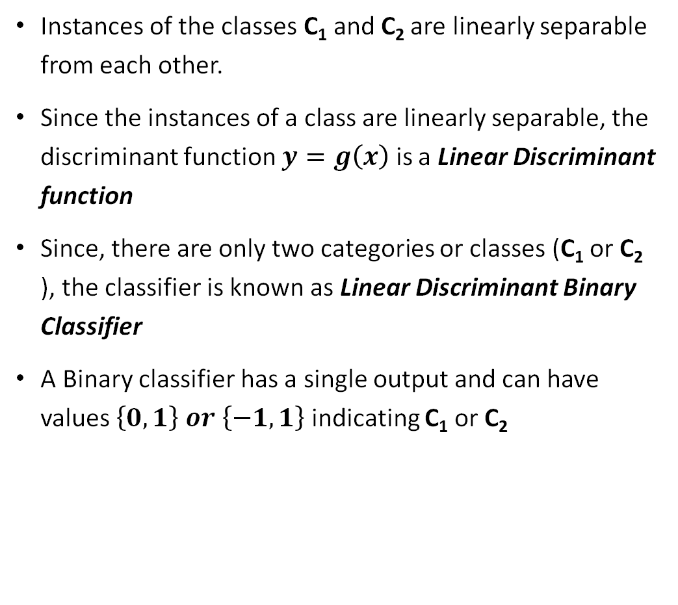
Linear discriminant Binary classifier
Instances of the classes C₁ and C₂ are linearly separable from each other.
Since the instances of a class are linearly separable, the discriminant function $y=g\left(x\right)$ is a Linear Discriminant function
Since, there are only two categories or classes (C₁ or C₂ ), the classifier is known as Linear Discriminant Binary Classifier
A Binary classifier has a single output and can have values $\left\{0, 1\right\} or \left\{−1, 1\right\}$ indicating C₁ or C₂
$$g\left(x\right)>0$$
C₁
C₂
$$g\left(x\right)<0$$
+
$$g\left(x\right)$$

Slide 5

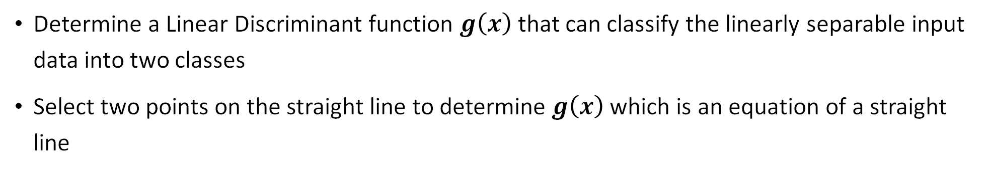


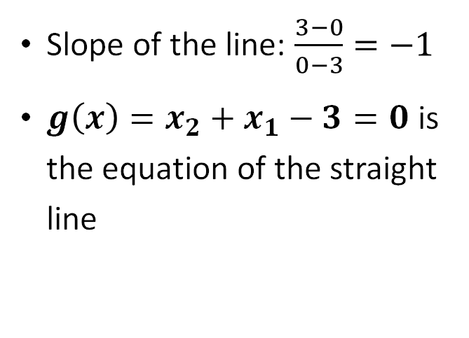


Linear discriminant Binary classifier
$$p_{2}\left(0, 3\right)$$
$$g\left(x\right)>0$$
C₁
Slope of the line: $\frac{3−0}{0−3}=−1$
$g\left(x\right)=x_{2}+x_{1}−3=0$ is the equation of the straight line
C₂
$$p_{1}\left(3, 0\right)$$
$$g\left(x\right)<0$$
+
$$g\left(x\right)$$
Determine a Linear Discriminant function $g\left(x\right)$ that can classify the linearly separable input data into two classes
Select two points on the straight line to determine $g\left(x\right)$ which is an equation of a straight line

Slide 6
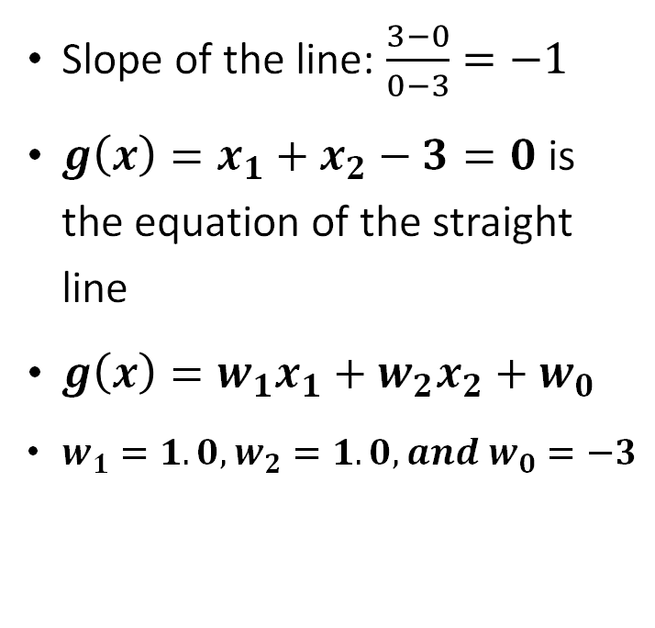
Linear discriminant Binary classifier
Slope of the line: $\frac{3−0}{0−3}=−1$
$g\left(x\right)=x_{1}+x_{2}−3=0$ is the equation of the straight line
$g\left(x\right)=w_{1}x_{1}+w_{2}x_{2}+w_{0}$
$w_{1}=1.0, w_{2}=1.0, and w_{0}=−3$
$$p_{2}\left(0, 3\right)$$
$$g\left(x\right)>0$$
C₁
C₂
$$p_{1}\left(3, 0\right)$$
$$g\left(x\right)<0$$
+
$$g\left(x\right)$$
Determine a Linear Discriminant function $g\left(x\right)$ that can classify the linearly separable input data into two classes
Select two points on the straight line to determine $g\left(x\right)$ which is an equation of a straight line

Slide 7





Linear discriminant Binary classifier
$$p_{2}\left(0, 3\right)$$
$$g\left(x\right)>0$$
C₁
C₂
$$p_{1}\left(3, 0\right)$$
$$g\left(x\right)<0$$
+
$$g\left(x\right)$$
Since the instances of the classes were linearly separable, the Linear Discriminant function $g\left(x\right)$ was able to classify the input data accurately.

Slide 8



Linear discriminant Binary classifier
Verify the performance of the $g\left(x\right)=x_{1}+x_{2}−3=0$ to classify the Test Input Data which has not been used in determining $g\left(x\right)$
$$g\left(x\right)>0$$
C₁
C₂
$$g\left(x\right)<0$$
+
$$g\left(x\right)$$

Slide 9
Linear discriminant Binary classifier
Determine the Linear Discriminant Function $g\left(x\right)$ to classify the Training Input Data shown below:

Slide 10
Perceptron

Slide 11
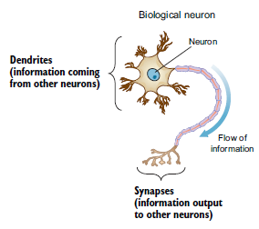
Perceptron – basic unit of artificial neural network
Perceptron is the simplest neural network, which consists of a single neuron
Conceptually, the perceptron functions in a manner similar to a biological neuron
A biological neuron receives electrical signals from its dendrites as inputs
A biological neuron modulates the input electrical signals in various amounts
A biological neuron fires an output signal through its synapses only when the total strength of the input signals exceeds a certain threshold
Ref: Deep Learning for Vision Systems, Mohamed Elgendy

Slide 12

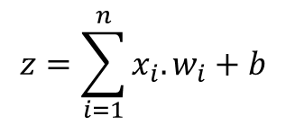
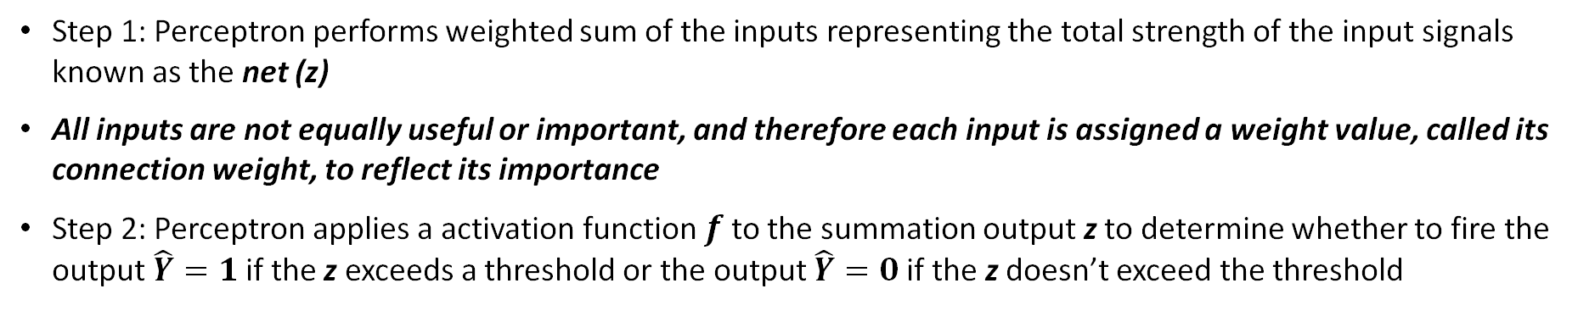

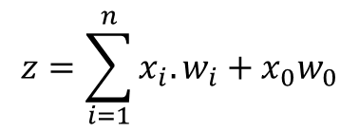

Perceptron – artificial model of biological neuron
Step 1: Perceptron performs weighted sum of the inputs representing the total strength of the input signals known as the net (z)
All inputs are not equally useful or important, and therefore each input is assigned a weight value, called its connection weight, to reflect its importance
Step 2: Perceptron applies a activation function $f$ to the summation output z to determine whether to fire the output $\hat{Y}=1$ if the z exceeds a threshold or the output $\hat{Y}=0$ if the z doesn’t exceed the threshold
x₀ = 1
w₀
$$z=\sum_{i=1}^{n}{x_{i}.w_{i}}+x_{0}w_{0}$$
x₁
w₁
z
∑
$$f$$
Output $\hat{Y}$
w₂
x₂
$x_{0}w_{0}$ is known as bias (b) or threshold
$$z=\sum_{i=1}^{n}{x_{i}.w_{i}}+b$$
w_{n}
x_{n}

Slide 13
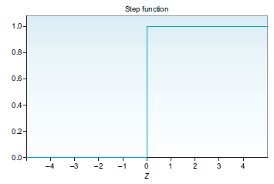

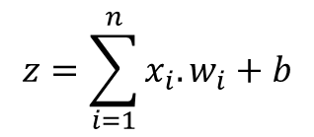
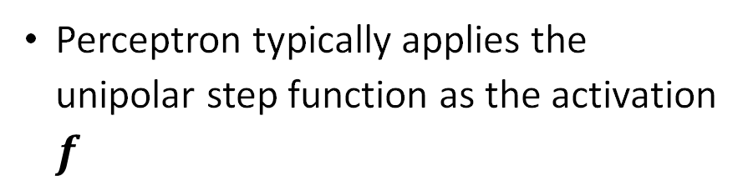

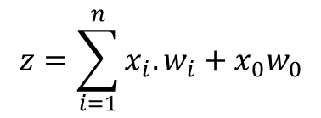
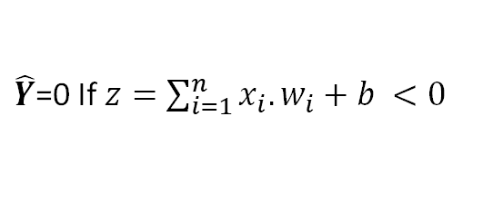

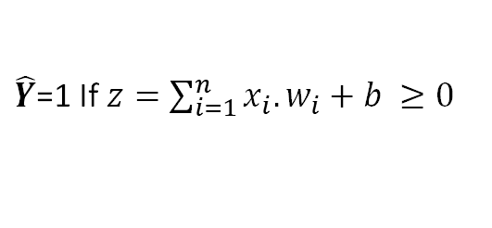
Perceptron – artificial model of biological neuron
x₀ = 1
$$z=\sum_{i=1}^{n}{x_{i}.w_{i}}+x_{0}w_{0}$$
w₀
x₁
w₁
z
∑
$$f$$
Output $\hat{Y}$
$x_{0}w_{0}$ is known as bias (b) or threshold
w₂
$$z=\sum_{i=1}^{n}{x_{i}.w_{i}}+b$$
x₂
w_{n}
x_{n}
$\hat{Y}$=1 If $z=\sum_{i=1}^{n}{x_{i}.w_{i}}+b ≥0$
Perceptron typically applies the unipolar step function as the activation $f$
$\hat{Y}$=0 If $z=\sum_{i=1}^{n}{x_{i}.w_{i}}+b <0$
Ref: Deep Learning for Vision Systems, Mohamed Elgendy

Slide 14









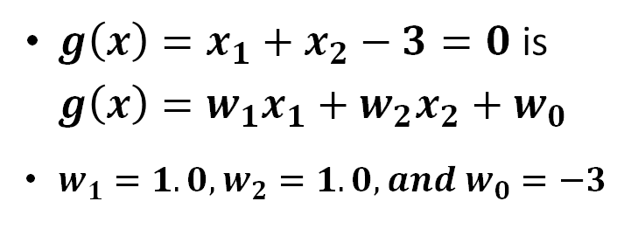
Binary classifier - perceptron
$g\left(x\right)=x_{1}+x_{2}−3=0$ is $g\left(x\right)=w_{1}x_{1}+w_{2}x_{2}+w_{0}$
$w_{1}=1.0, w_{2}=1.0, and w_{0}=−3$
$$p_{2}\left(0, 3\right)$$
$$g\left(x\right)>0$$
C₁
C₂
$$p_{1}\left(3, 0\right)$$
$$g\left(x\right)<0$$
+
Artificial Neuron
$$g\left(x\right)$$
Inputs
Perceptron
b =1
x₀ = 1
w₀ = -3
x₁
∑|$f$
$$\hat{Y}$$
$$f$$
x₁
w₁ = 1.0
x₂
∑
net(z)
1
w₂ = 1.0
0
$$\hat{Y}$$
x₂

Slide 15
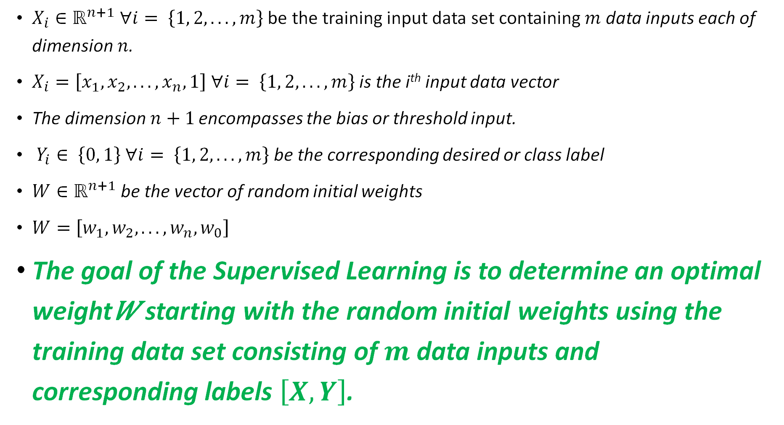
Perceptron – supervised learning (math)
$X_{i}∈ℝ^{n+1} ∀i= \left\{1, 2, . . ., m\right\}$ be the training input data set containing $m$ data inputs each of dimension $n$.
$X_{i}=\left[x_{1}, x_{2}, . . ., x_{n}, 1\right] ∀i= \left\{1, 2, . . ., m\right\}$ is the i^{th} input data vector
The dimension $n+1$ encompasses the bias or threshold input.
$Y_{i}∈ \left\{0, 1\right\} ∀i= \left\{1, 2, . . ., m\right\}$ be the corresponding desired or class label
$W∈ℝ^{n+1}$ be the vector of random initial weights
$W=\left[w_{1}, w_{2}, . . ., w_{n}, w_{0}\right]$
The goal of the Supervised Learning is to determine an optimal weight𝑊 starting with the random initial weights using the training data set consisting of $m$ data inputs and corresponding labels $\left[X,Y\right]$.

Slide 16



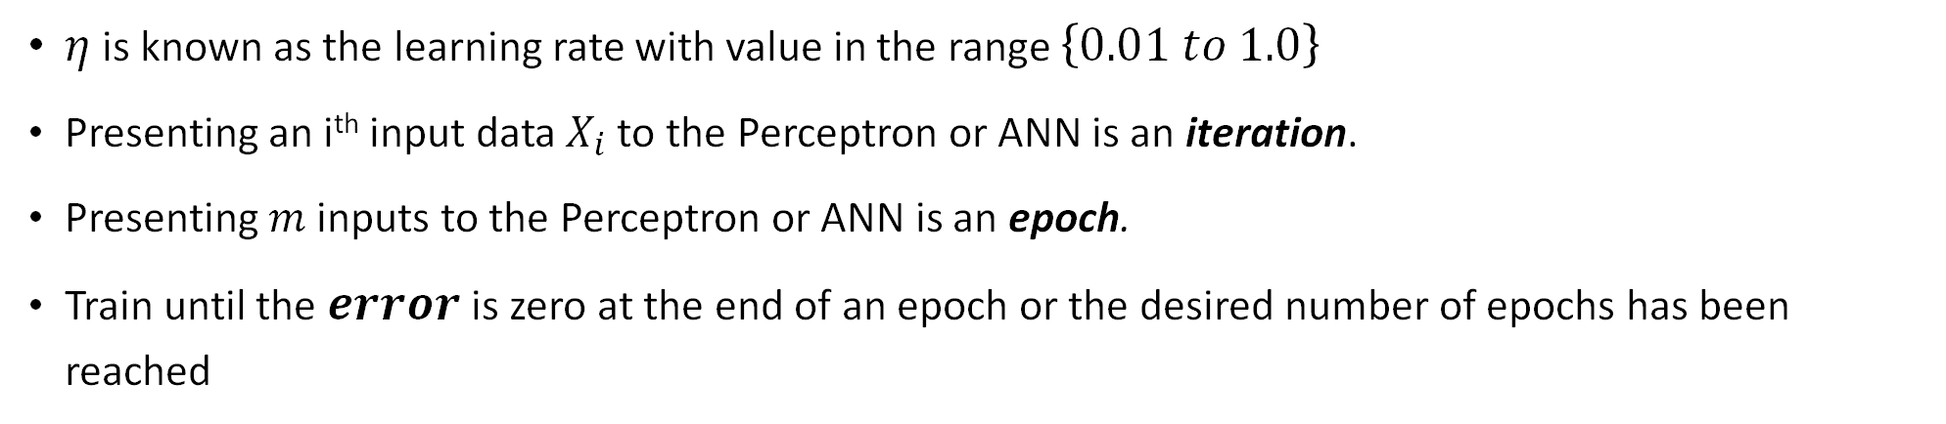



Perceptron – supervised learning
X_{i}
W
x₁
x₂
.
.
.
x_{n}
1
w₁
w₂
∑|$f$
$\hat{Y_{i}}$ (Predicted)
w_{n}
w₀
$$error=Y_{i}−\hat{Y_{i}}$$
$Y_{i}$ (Desired)
$$W←W+∆W$$
$∆W=η\left(Y_{i}−\hat{Y_{i}}\right)X_{i}$
$η$ is known as the learning rate with value in the range $\left\{0.01 to 1.0\right\}$
Presenting an i^{th} input data $X_{i}$ to the Perceptron or ANN is an iteration.
Presenting $m$ inputs to the Perceptron or ANN is an epoch.
Train until the $error$ is zero at the end of an epoch or the desired number of epochs has been reached

Slide 17
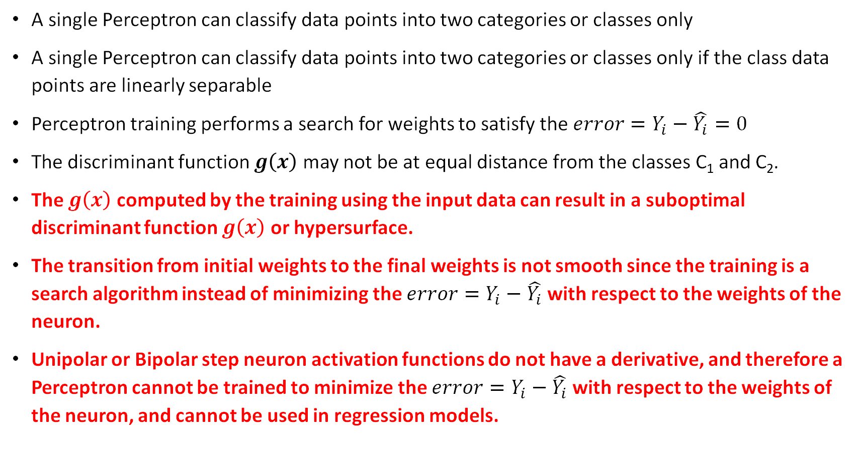
Drawbacks of perceptron
A single Perceptron can classify data points into two categories or classes only
A single Perceptron can classify data points into two categories or classes only if the class data points are linearly separable
Perceptron training performs a search for weights to satisfy the$error=Y_{i}−\hat{Y_{i}}=0$
The discriminant function $g\left(x\right)$ may not be at equal distance from the classes C₁ and C₂.
The $g\left(x\right)$ computed by the training using the input data can result in a suboptimal discriminant function $g\left(x\right)$ or hypersurface.
The transition from initial weights to the final weights is not smooth since the training is a search algorithm instead of minimizing the $error=Y_{i}−\hat{Y_{i}}$ with respect to the weights of the neuron.
Unipolar or Bipolar step neuron activation functions do not have a derivative, and therefore a Perceptron cannot be trained to minimize the $error=Y_{i}−\hat{Y_{i}}$ with respect to the weights of the neuron, and cannot be used in regression models.

Slide 18
Multilayered perceptron network
Non-linearly separable Two classes
Requires two discriminant functions in the First or Input Layer of the Multilayered Perceptron Network
Require a discriminant function in the Second or Output Layer of the Multilayered Perceptron Network
X₁ | X₂ | Labels | CLASS
2 | 2 | 1 | C₁
2 | 1.5 | 1 | C₁
-2 | 0 | 1 | C₁
1 | 0 | 1 | C₁
3 | 0 | 1 | C₁
1 | 3 | -1 | C₂
3 | 3 | -1 | C₂
1 | 2 | -1 | C₂
3 | 2 | -1 | C₂
5 | 0 | -1 | C₂

Slide 19


Multilayered perceptron network
Input Layer to transfer Non-linearly separable Two classes to Linearly Separable Two Classes
0.44
O₁
X₁
∑|$f$
-1
1.33
1
1
O₂
X₂
∑|$f$
-4.5
Bias = 1

Slide 20

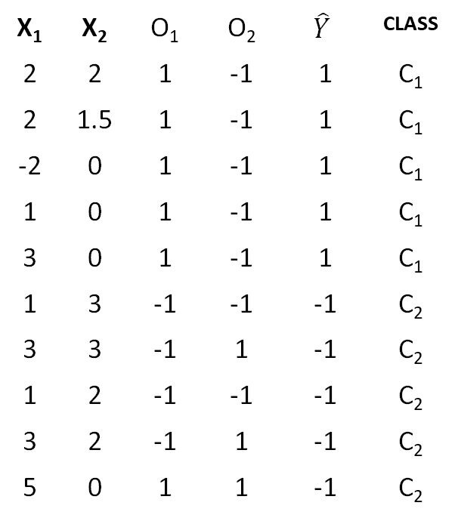



Multilayered perceptron network
Output Layer to classify the Linearly Separable Two Classes
Multilayered Perceptron Network with infinite number of layers and Perceptrons is an Universal Approximator.
Not suitable for Practical Applications
X₁ | X₂ | O₁ | O₂ | $$\hat{Y}$$ | CLASS
2 | 2 | 1 | -1 | 1 | C₁
2 | 1.5 | 1 | -1 | 1 | C₁
-2 | 0 | 1 | -1 | 1 | C₁
1 | 0 | 1 | -1 | 1 | C₁
3 | 0 | 1 | -1 | 1 | C₁
1 | 3 | -1 | -1 | -1 | C₂
3 | 3 | -1 | 1 | -1 | C₂
1 | 2 | -1 | -1 | -1 | C₂
3 | 2 | -1 | 1 | -1 | C₂
5 | 0 | 1 | 1 | -1 | C₂
0.44
∑|$f$
O₁
X₁
1
-1
$$\hat{Y}$$
1.33
∑|$f$
1
-1
1
X₂
∑|$f$
O₂
-1
-4.5
Bias = 1
Input Layer
Bias = 1
Output Layer

Slide 21
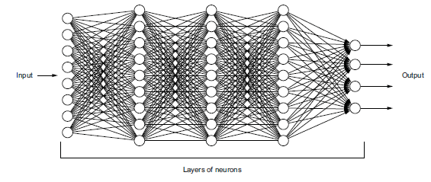
Artificial neural network, FCN and DNN
Ref: Deep Learning for Vision Systems, Mohamed Elgendy
Output Layer
Input Layer
Hidden Layer
Hidden Layer
Hidden Layer
ANN with every neuron connected to neurons in the subsequent layer is known as Fully Connected Network (FCN) or Dense Network
ANN with large number of hidden layers results is known as a Deep Neural Network (DNN)
A Deep Neural Network is not required to be a FCN.

Slide 22
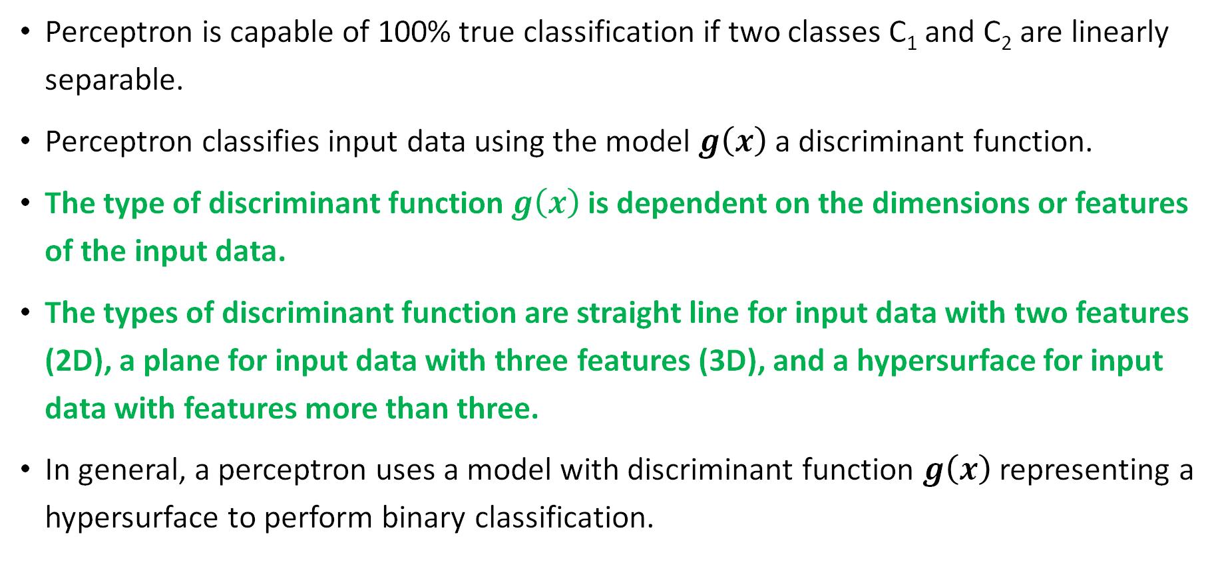
Perceptron –summary
Perceptron is capable of 100% true classification if two classes C₁ and C₂ are linearly separable.
Perceptron classifies input data using the model $g\left(x\right)$ a discriminant function.
The type of discriminant function $g\left(x\right)$ is dependent on the dimensions or features of the input data.
The types of discriminant function are straight line for input data with two features (2D), a plane for input data with three features (3D), and a hypersurface for input data with features more than three.
In general, a perceptron uses a model with discriminant function $g\left(x\right)$ representing a hypersurface to perform binary classification.

Slide 23
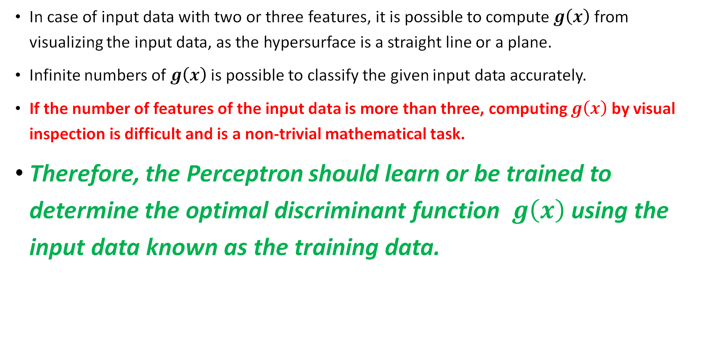
Perceptron – summary
In case of input data with two or three features, it is possible to compute $g\left(x\right)$ from visualizing the input data, as the hypersurface is a straight line or a plane.
Infinite numbers of $g\left(x\right)$ is possible to classify the given input data accurately.
If the number of features of the input data is more than three, computing $g\left(x\right)$ by visual inspection is difficult and is a non-trivial mathematical task.
Therefore, the Perceptron should learn or be trained to determine the optimal discriminant function $g\left(x\right)$ using the input data known as the training data.

Slide 24
Programming Perceptron and MLP

Slide 25
Programming Perceptrons and MLP
We will be using scikit-learn (sklearn) because:
It was developed specifically for python which is currently the most popular ML programming language
It is currently the most prevalent ML library in both industry and academia? Double check this
It provides a simple introduction to ML by abstracting the model construction, training, and testing
Some drawbacks and limitations of scikit-learn include:
ML network complexity is limited by its black box approach. Our control over model training and construction is limited
ML network architectures are limited to MLP, with no support for more complex vision or temporal models
Automatic GPU offloading is not supported, this makes training large models computationally infeasible
Open the "perceptron_template.ipynb" Jupyter Notebook

Slide 26
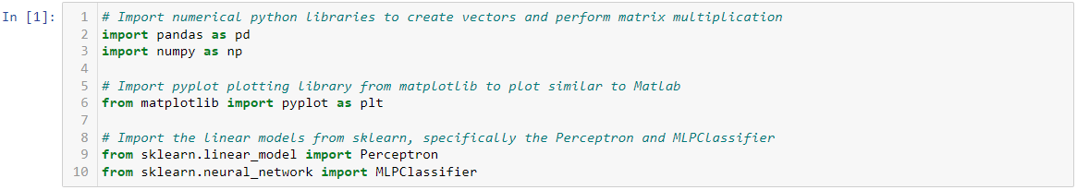
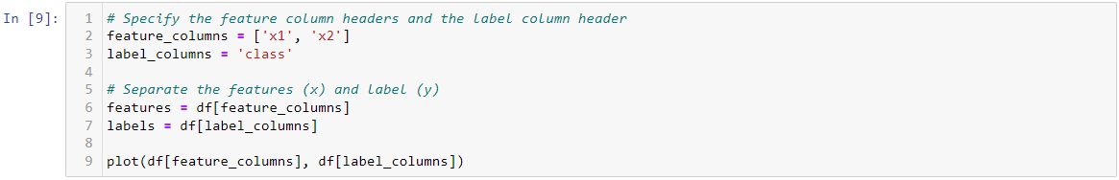
Programming Perceptrons and MLP

Slide 27
Programming Perceptrons and MLP

Slide 28
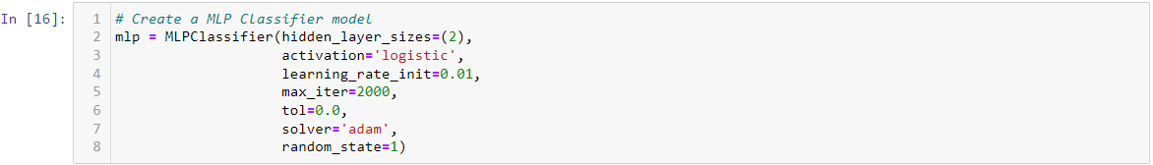
Programming Perceptrons and MLP

